Slide 1
cryptocurrency
Volatility As a Function Of Market Dynamics

Slide 2
What is a Cryptocurrency?
Cryptocurrencies are cryptographically created digital tokens that can be used as a medium of exchange and a store of value without the need of physical tender.

Slide 3
cryptocurrency
Volatility As a Function Of Market Dynamics

Slide 4
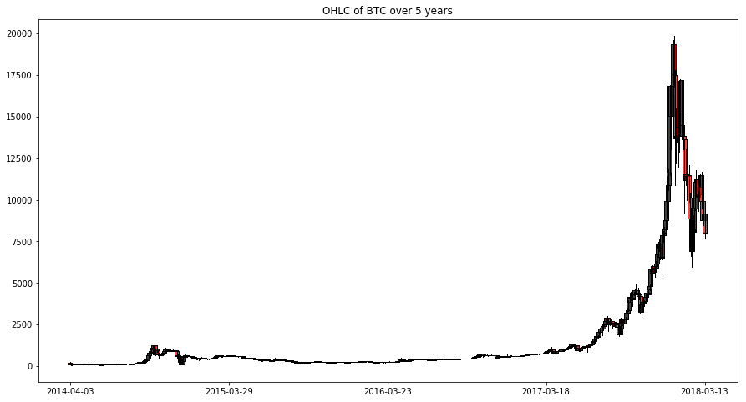
Price analysis of Bitcoin over 5 years. We selected Bitcoin as they are the crypto market leader.

Slide 5
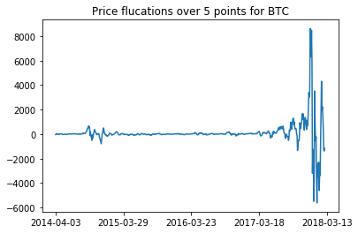
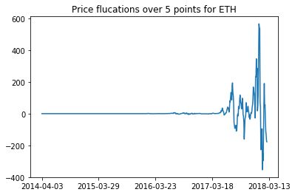
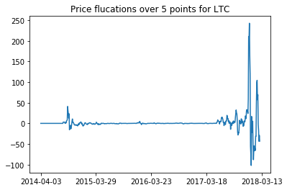
Price change (velocity) analysis

Slide 6
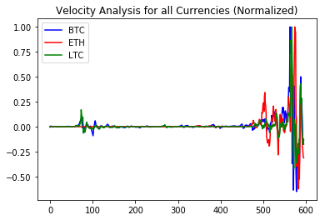
Normalized price changes

Slide 7
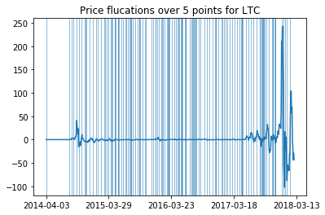
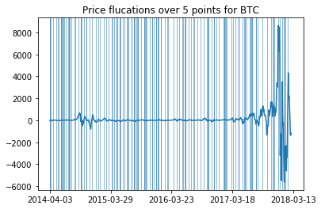
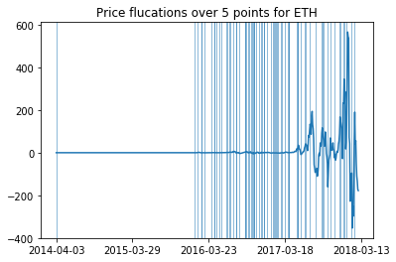
Velocity analysis identifying peaks

Slide 8
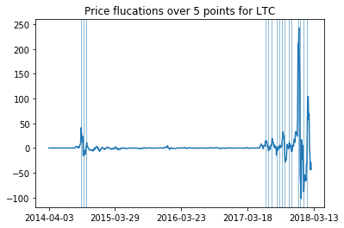
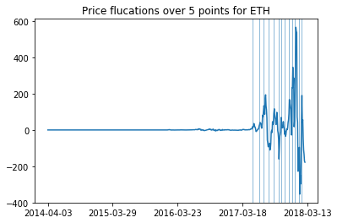
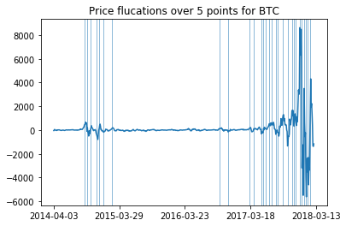
Identifying peaks (filtered)

Slide 9
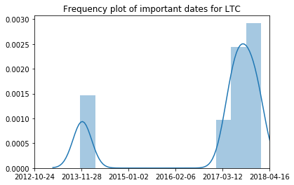
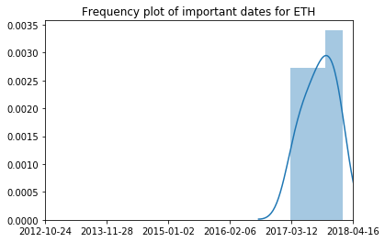
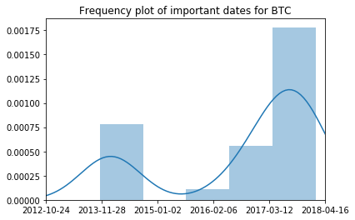
Important dates
Important Dates for BTC:
2013-11-13
2013-11-28
2013-12-25
2014-02-02
2014-02-20
2014-03-19
2014-05-18
2016-05-28
2016-07-24
2016-12-15
2017-01-17
2017-03-09
2017-03-24
2017-04-05
2017-05-02
2017-05-17
2017-06-16
2017-06-28
2017-08-03
2017-09-05
2017-10-05
2017-10-20
2017-11-01
2017-11-28
2017-12-13
2017-12-25
2018-01-09
2018-01-21
2018-02-08
Important Dates for ETH:
2017-03-06
2017-04-20
2017-05-23
2017-06-25
2017-07-31
2017-09-02
2017-09-20
2017-10-14
2017-11-13
2017-12-04
2017-12-25
2018-01-21
2018-02-08
Important Dates for LTC
2013-11-19
2013-12-04
2013-12-25
2017-04-26
2017-05-17
2017-06-07
2017-07-10
2017-07-31
2017-08-18
2017-09-05
2017-10-05
2017-10-20
2017-12-04
2017-12-19
2018-01-12
2018-02-05

Slide 10
4 year stock history of apple and microsoft

Slide 11
Acceleration analysis of apple and Microsoft stock history

Slide 12
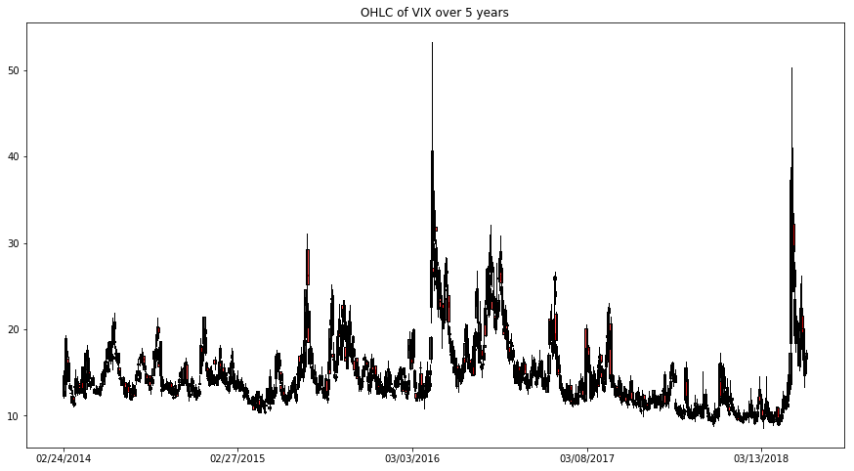

Slide 13
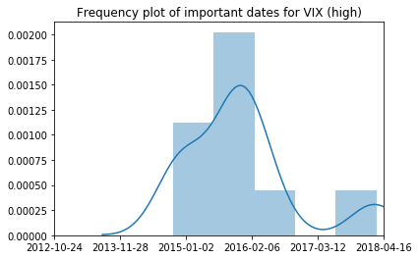
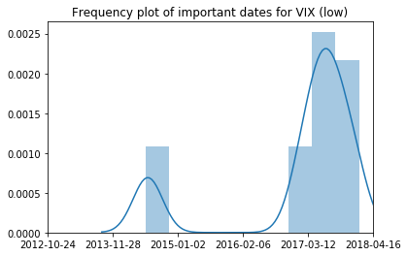
Important date frequency analysis for volatility index

Slide 14
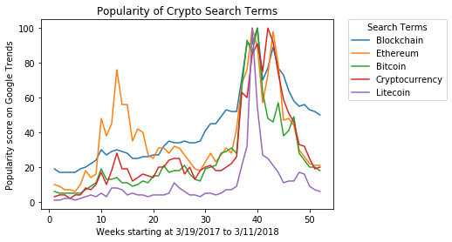
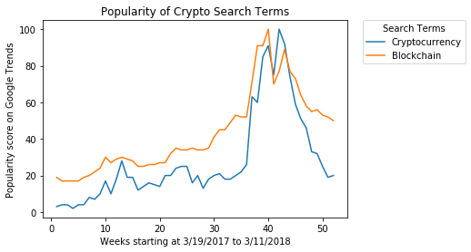
Google Trends Searches

Slide 15
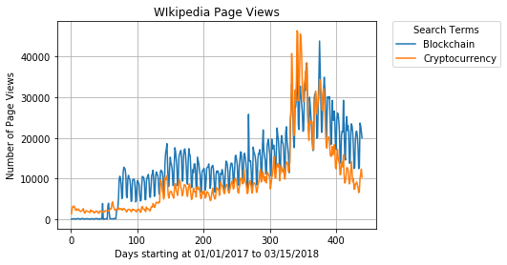
Wikipedia Page views

